Slide 1
Kaya Uke
My project? Neural Implant for Epilepsy Design of Neural Interface of the Implant: Electrode/Probe | What I did last four weeks? Literature review: State of the art probes Identified Challenges Future Trends
Problem being faced? Learn to Simulate (FEM-Comsol) Practical microfabrication (JWS Nanofab) | What to do in next two weeks? Literature review: Seizure specific design Further Lit Rev Thesis Outline Design Methodology Simulation(COMSOL)

Slide 2
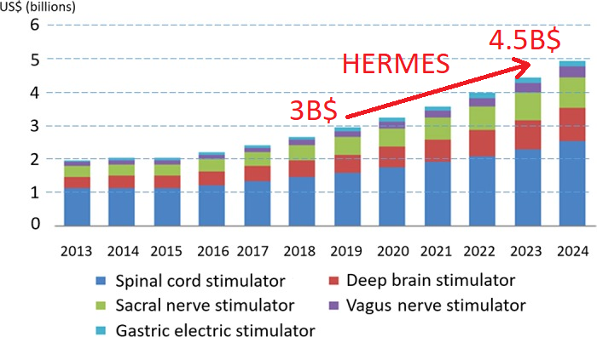
WHY?
Passion
Future
Growth
Source: [1]

Slide 3
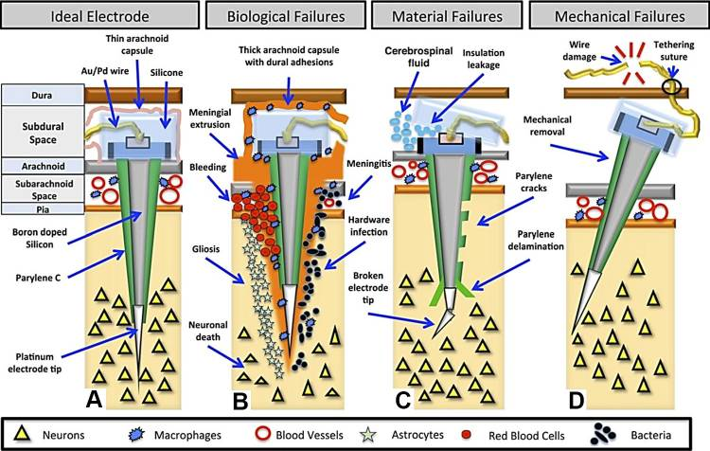
Challenges
[1]

Slide 4
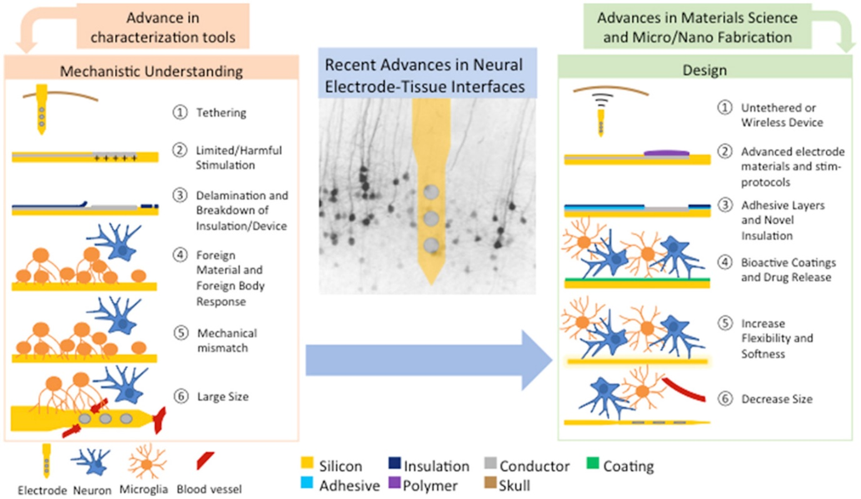
Future Trends: Recent advances in neural electrode–tissue interfaces
[2]

Slide 5
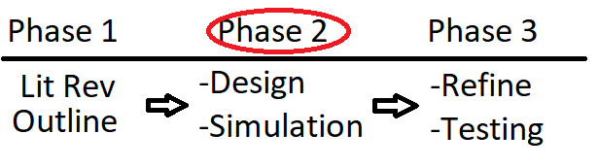
Process

Slide 6
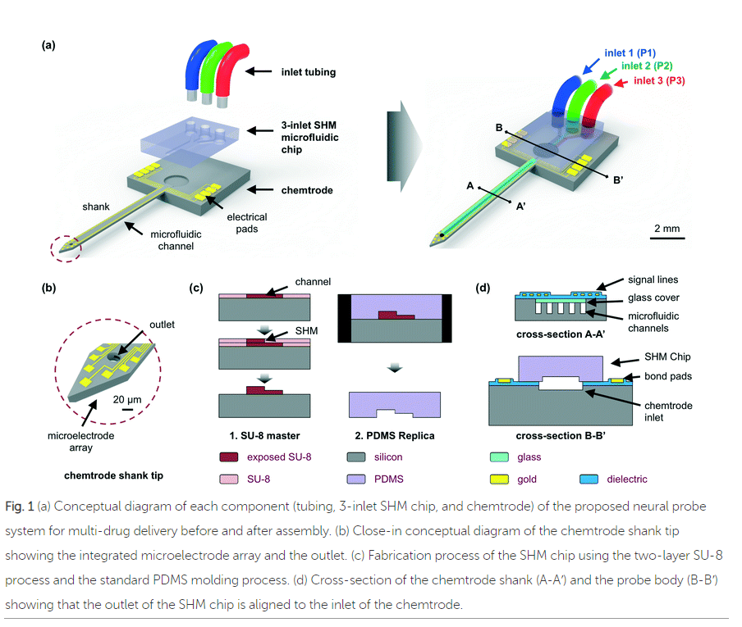
microFabrication
[3]

Slide 7
Tasks/Questions
Further Lit Rew: Seizure specific probe design
Learn COMSOL/FEM
Learn/Refine Design and Process
microFabrication at JWSN?
Practical experience?

Slide 8
References
Prochazka A. (2017). Neurophysiology and neural engineering: a review. Journal of neurophysiology, 118(2), 1292–1309. doi:10.1152/jn.00149.2017
Woeppel, K., Yang, Q. and Cui, X. (2017). Recent advances in neural electrode–tissue interfaces. Current Opinion in Biomedical Engineering, 4, pp.21-31.
Shin, H., Lee, H., Chae, U., Kim, H., Kim, J., Choi, N., Woo, J., Cho, Y., Lee, C., Yoon, E. and Cho, I. (2015). Neural probes with multi-drug delivery capability. Lab on a Chip, 15(18), pp.3730-3737.

